Slide 1
Data Science Unit-IV
Random forest
From : Web resources

Slide 2
Ensemble Algorithms
These algorithms combines the decisions from multiple models to improve the overall performance.
This approach allows the production of better predictive performance compared to a single model.
Advantage : Improvement in predictive accuracy. Disadvantage : It is difficult to understand an ensemble of classifiers.
Basic Ensemble Techniques Max Voting, Averaging, Weighted Average
2. Advanced Ensemble Techniques Stacking, Blending, Bagging, Boosting
3. Algorithms based on Bagging and Boosting Bagging : Bagging meta-estimator Random Forest Boosting: AdaBoost ,GBM, XGB, Light GBM, CatBoost

Slide 3
Why do ensembles work?
It address the following problems
Statistical Problem The Computational Problem arises when the learning algorithm cannot guarantees finding the best hypothesis.
Representational Problem The Representational Problem arises when the hypothesis space does not contain any good approximation of the target class(es).

Slide 4
Types of ensemble method
There are many ensemble techniques available, but we will discuss about the below two most widely used methods:
1. Bagging
2. Boosting
Let us first understand the similarities and differences between both terminologies.
Both the methods can be used for classification (discrete output) and regression (continuous output) problems.
­Both methods are better in performance compared to single models as they aggregate the output of all the weak learners via voting thereby leading to more accuracy in the predictions.

Slide 5
Bagging( Bootstrap Aggregation)
Bagging (Bootstrap Aggregation) is used to reduce the variance of a decision tree. Suppose a set D of d tuples, at each iteration i, a training set D_{i} of d tuples is sampled with replacement from D (i.e., bootstrap).
Then a classifier model M_{i} is learned for each training set D < i.
Each classifier M_{i} returns its class prediction.
The bagged classifier M* counts the votes and assigns the class with the most votes to X (unknown sample).

Slide 6
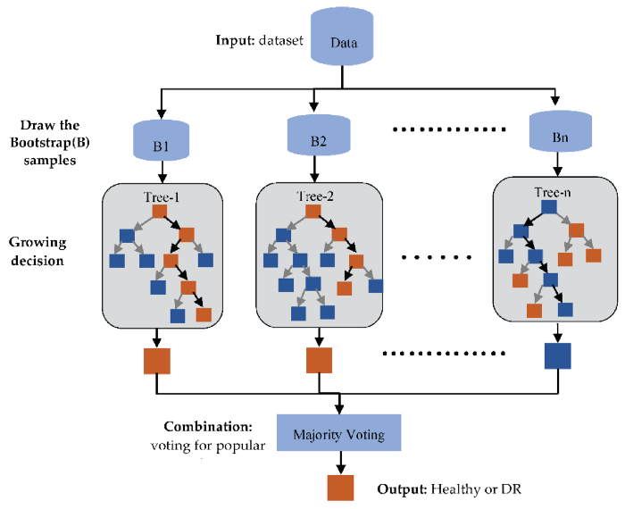
Implementation steps of Bagging(Bootstrap)
Multiple subsets are created from the original data set with equal tuples, selecting observations with replacement.(Row sampling replacement)
A base model is created on each of these subsets.
Each model is learned in parallel from each training set and independent of each other.
The final predictions are determined by combining the predictions from all the models. Classify by majority voting

Slide 7
Boosting
The idea of Boosting method is that instead of using a simple algorithm, which is not strong enough to make the accurate predictions alone as there are high variance and error rate, we combine multiple simple learning algorithms together, rather than finding a single highly accurate prediction rule.
The Boosting algorithm then combines these multiple weak rules together to reduce variance and bias in individual model rules into a single prediction rule, such that it will be much more accurate than any one of the weak rules as.

Slide 8
Boosting
Two fundamental approaches for effective implementation of Boosting algorithm:
Choosing the different subsets from training dataset for different iterations:
To increase the efficiency of the base learner predictions, high weightage is placed on the examples that were misclassified by earlier weak learner.
How to combine weak leaners together:
Taking a weighted majority vote of the predictions.

Slide 9
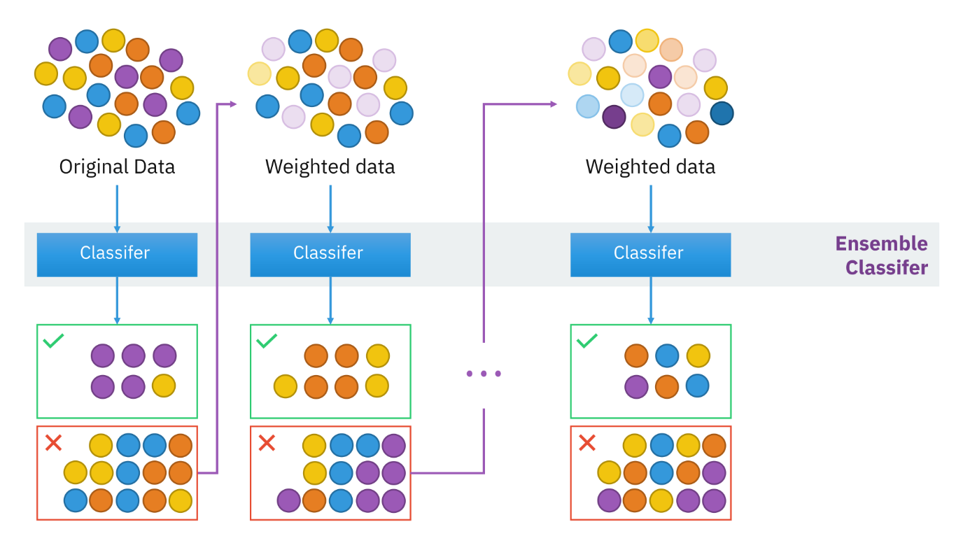
Boosting

Slide 10
Boosting Algorithm
Step 1: All observations have equal weight in the original training data set D₁. An initial “base” classifier h₁ is determined.
Step 2: The observations that were incorrectly classified by the previous base classifier have their weights increased, while the observations that were correctly classified have their weights decreased.
This gives us data distribution D_{m}, m=2, … , M.
A new base classifier hm, m = 2, … , M is determined, based on the new weights. This step is repeated until the desired number of iterations M is achieved.
Step 3: The final boosted classifier is the weighted sum of the M base classifiers

Slide 11
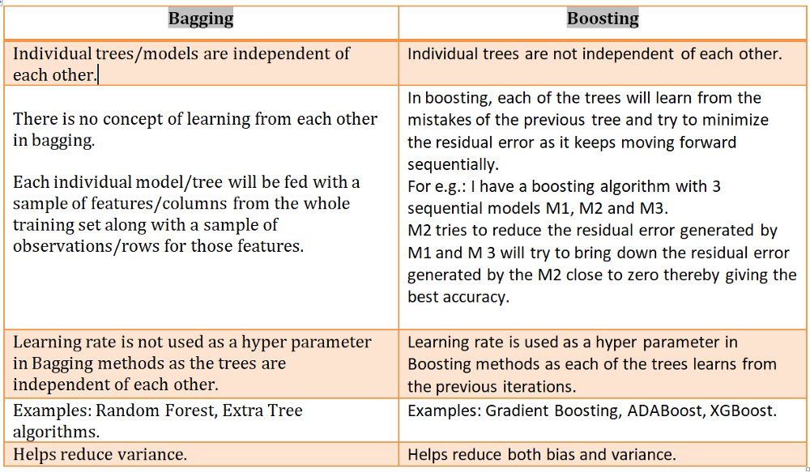
Differences Bagging and Boosting

Slide 12
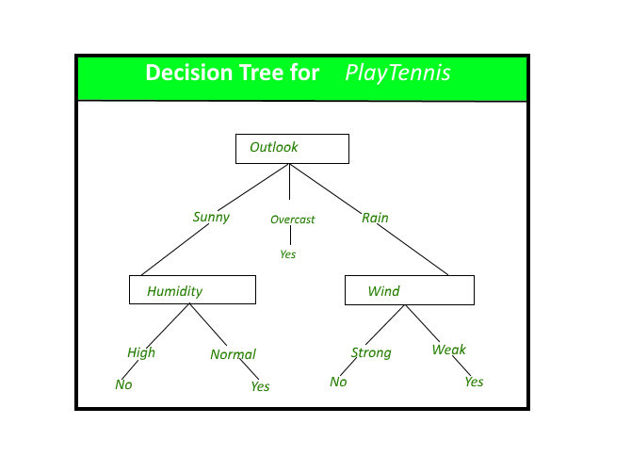
Decision tree: Its issues
Decision tree is the most powerful and popular tool for classification and prediction.
A Decision tree is a flowchart like tree structure, where each internal node denotes a test on an attribute, each branch represents an outcome of the test, and each leaf node (terminal node) holds a class label.
Issues:
Overfitting the data: High variance, low bias
Guarding against bad attribute choices
Handling continuous valued attributes
Handling missing attribute values
Handling attributes with differing costs

Slide 13
Random forest
Random reduce high variance in Decision tree.
A Random forest is an ensemble learning method where multiple decision trees are constructed , trained by Bagging method and then they are merged to get a more accurate prediction.
Random forest is a supervised learning algorithm which is used for both classification as well as regression.
Forest is made up of trees and more trees means more robust forest.
Random forest algorithm creates decision trees on data samples and then gets the prediction from each of them and finally selects the best solution by means of voting.
It is an ensemble method which is better than a single decision tree because it reduces the over-fitting by averaging the result.

Slide 14
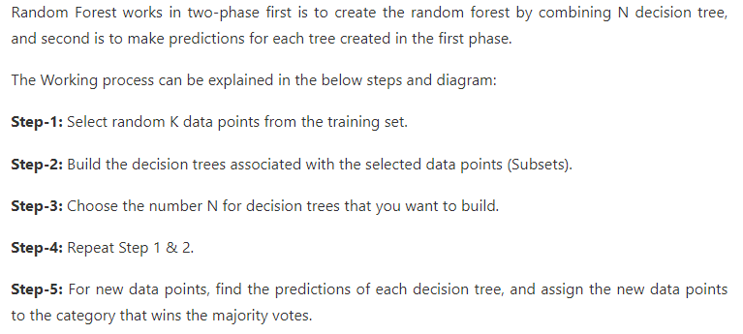
Random Forest

Slide 15
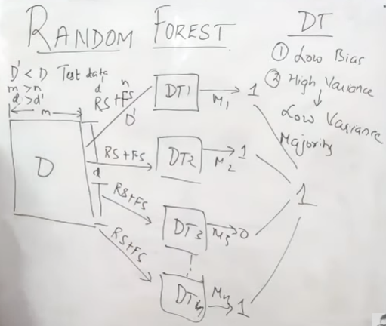
Random forest

Slide 16
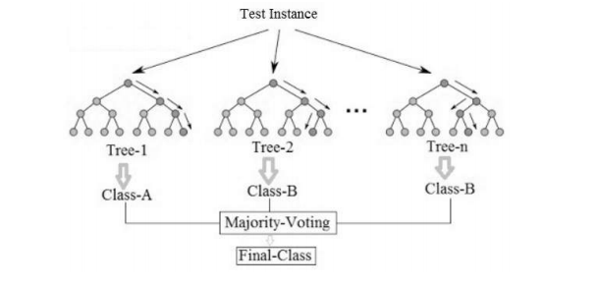
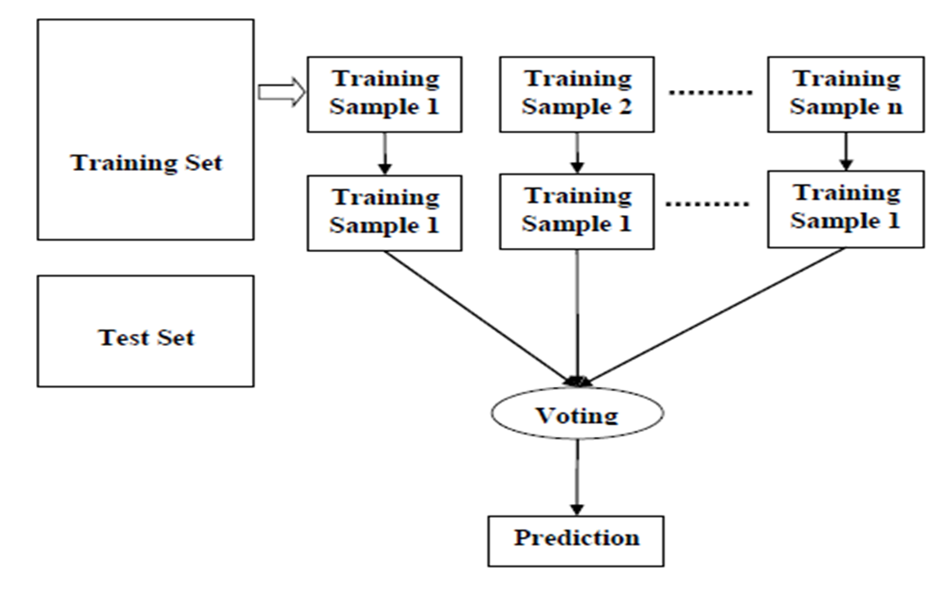
Example of random forest with majority voting

Slide 17
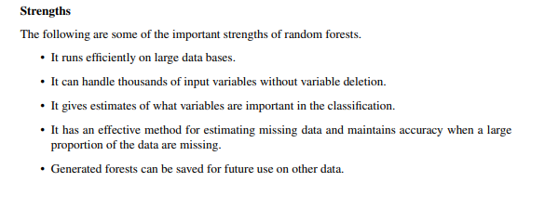
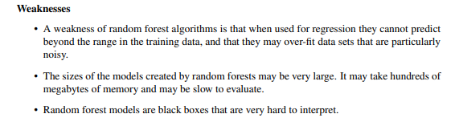
Strengths and weakness

Slide 18
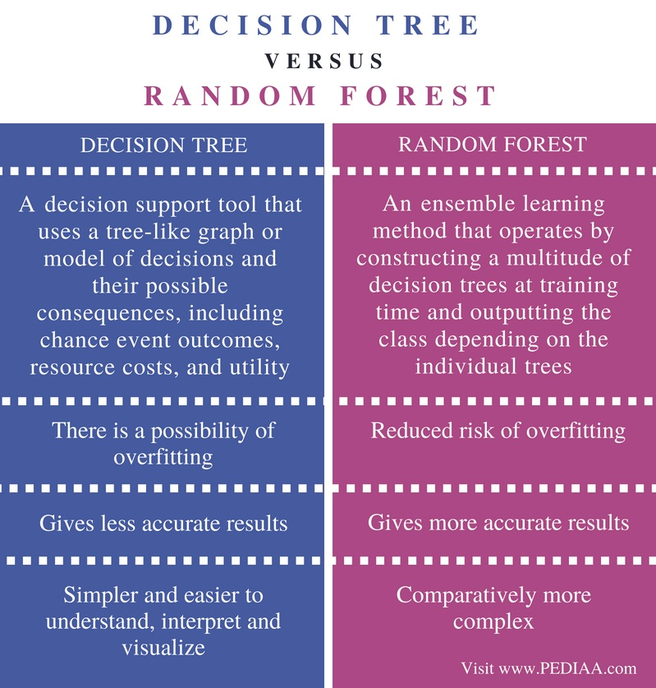
Difference between Decision tree, Random forest

Slide 19
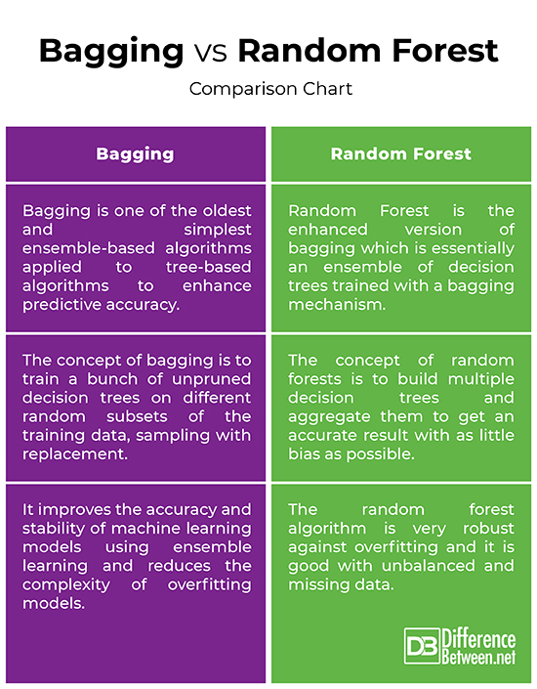
Difference between Bagging vs Random forest

Slide 20
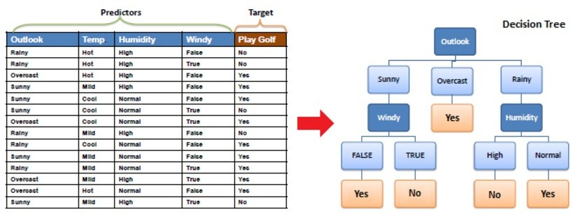
A simple example

Slide 21
Principled Criterion
●
●
Choosing the most useful attribute for classifying examples. Entropy
-
-
A measure of homogeneity of the set of examples
If the sample is completely homogeneous the entropy is zero and if the sample is an equally divided it has entropy of one
●
Information Gain
-
Measures how well a given attribute separates the training examples according to their target classification
This measure is used to select among the candidate attributes at each step while growing the tree
-

Slide 22
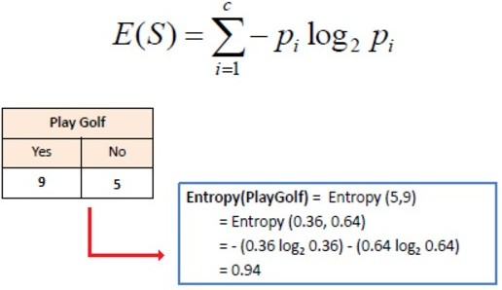
Information Gain
Step 1 : Calculate entropy of the target

Slide 23
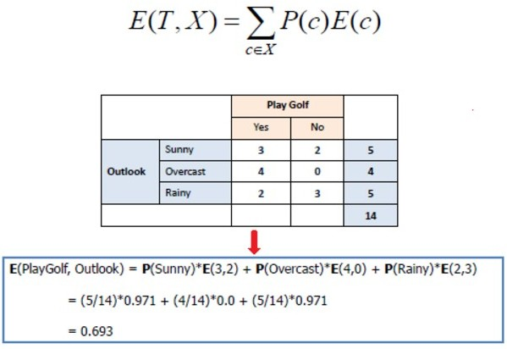
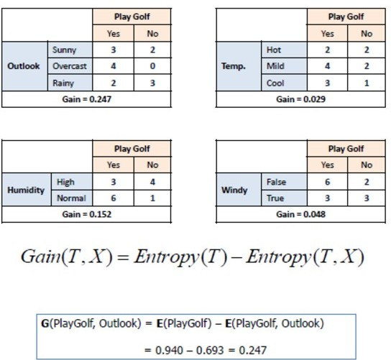
Information Gain (Cont’d)
Step 2 : Calculate information gain for each attribute

Slide 24
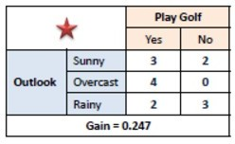
Information Gain (Cont’d)
Step 3: Choose attribute with the largest information gain as the decision node.

Slide 25
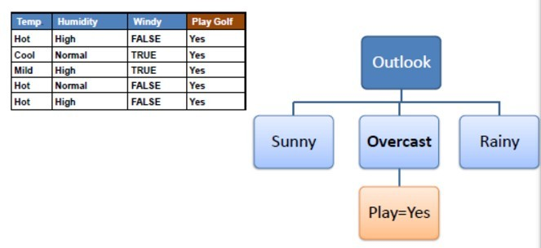
Information Gain (Cont’d)
Step 4a: A branch with entropy of 0 is a leaf node.

Slide 26
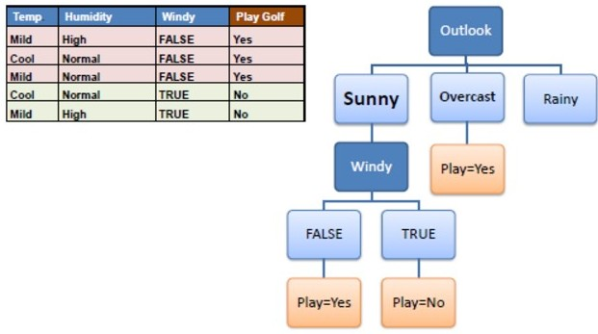
Information Gain (Cont’d)
Step 4b: A branch with entropy more than 0 needs further splitting.
Step 5: The algorithm is run recursively on the non-leaf branches, until all data is classified.

Slide 27

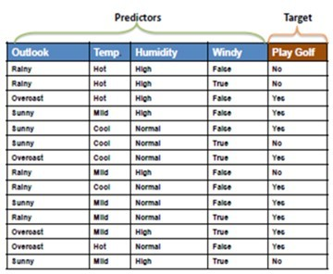
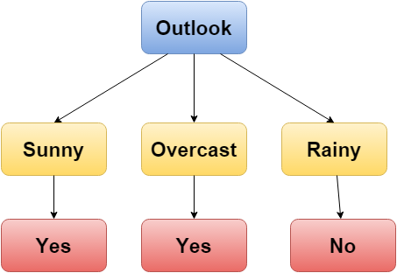
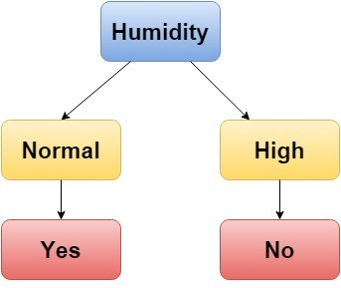

Decision Tree & Random Forest
Decision Tree
Random Forest
Tree 1
Tree 2
14
Tree 3

Slide 28
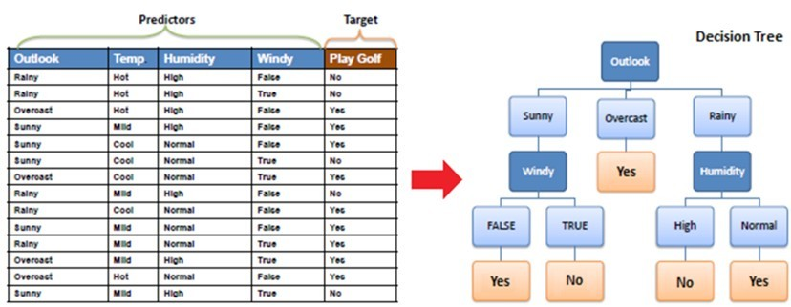
Decision Tree
Outlook | Temp. | Humidity | Windy | Play Golf
Rainy | Mild | High | False | ?
Result : No

Slide 29
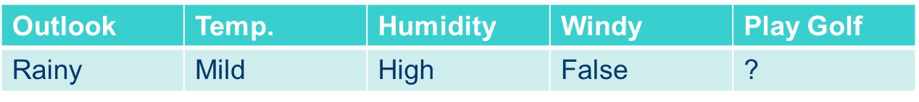
Random Forest
Tree 1 : No Tree 2 : No Tree 3 : Yes
Tree 1
Tree 2
Yes : 1
No : 2
Result : No
Tree 3

